Slide 1
Bullying and Harassment
Part of the DNA of Care Programme

Slide 2


Why does it matter?
“Most organisations have a serial bully. It never ceases to amaze me how one person's divisive dysfunctional behaviour can permeate the entire organisation like a cancer.”
Tim Field
“The frightening thing is how quickly your confidence erodes when you are in this situation.”
Annie Clayton
“Harmony cannot thrive in a climate of mistrust, cheating (and) bullying.”
Dalai Lama

Slide 3
Definitions
Harassment is unwanted conduct affecting the dignity of men and women in the workplace. It may be related to age, sex, race, disability, religion, sexual orientation, nationality or any personal characteristic of the individual, and may be persistent or an isolated incident. The key is that the actions or comments are viewed as demeaning and unacceptable to the recipient. Harassment is unlawful under the Equality Act 2010.
Bullying may be characterised as offensive, intimidating, malicious or insulting behaviour, an abuse or misuse of power through means intended to undermine, humiliate, denigrate or injure the recipient. Bullying or harassment may be by an individual against an individual (perhaps by someone in a position of authority such as a manager or supervisor) or involve groups of people. It may be obvious or it may be insidious. Whatever form it takes, it is unwarranted and unwelcome to the individual.
Should these definitions be referenced?

Slide 4
Impact of Bullying and Harassment
The latest NHS Staff survey shows that one in four NHS staff are reporting bullying or harassment by another member of staff.
Bullying and harassment causes stress and can result in physical and mental health problems. It damages morale and undermines team work, leading to poor performance.
Ultimately, bullying puts patient care and safety at risk.
The financial impact of bullying in the NHS is estimated at over £2 billion per year.

Slide 5
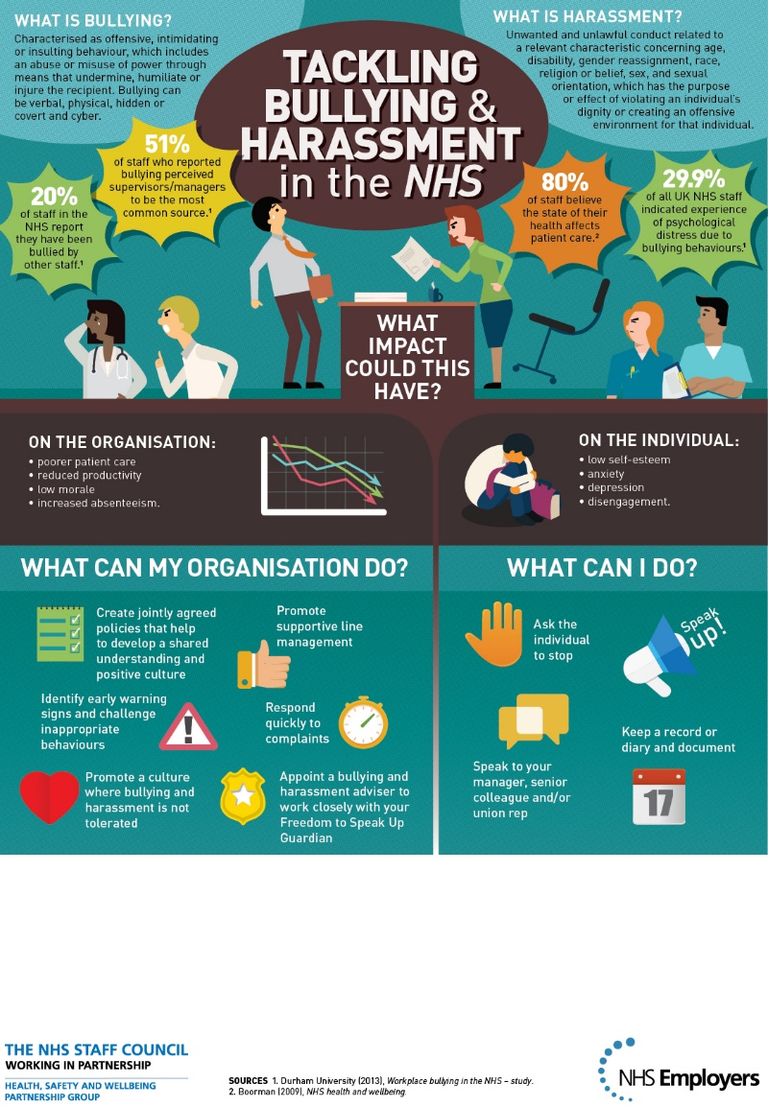
Impact of Bullying and Harassment in the NHS

Slide 6

The DNA of Care
“The intertwined relationship between patient care and staff well-being has been likened to the double helix. And so the stories we tell each other are like the DNA of care, transmitting information and shaping cultures, offering learning opportunities and, sometimes, healing.”
Pip Hardy and Tony Sumner, 2016

Slide 7
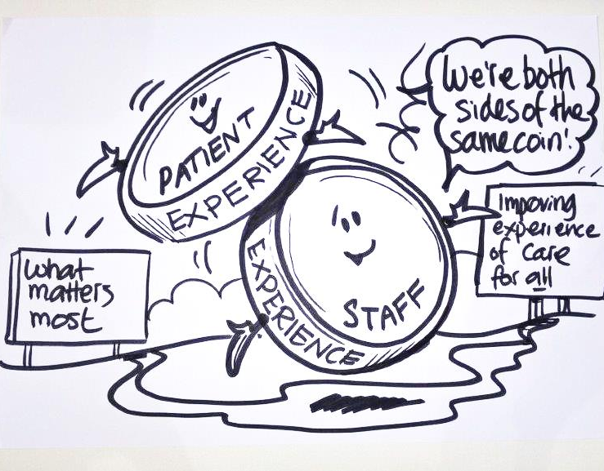
Two sides of the same coin
Staff experience drives patient experience.
‘Focusing on this relationship could be the most important move for the healthcare system to make.’
Karen Deeny, 2017

Slide 8
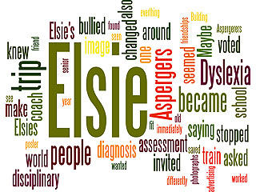
Diagnosis
http://www.patientvoices.org.uk/flv/1218pv384s.htm

Slide 9
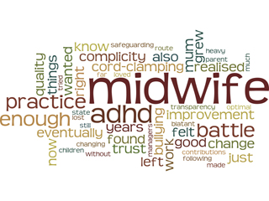
Betrayed
http://www.patientvoices.org.uk/flv/1212pv384s.htm

Slide 10
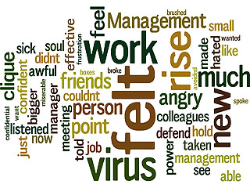
Rise above it
http://www.patientvoices.org.uk/flv/1215pv384s.htm

Slide 11
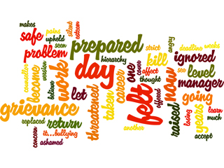
Choice
http://www.patientvoices.org.uk/flv/1216pv384s.htm

Slide 12
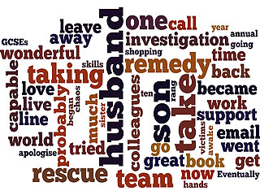
Rescue Remedy
http://www.patientvoices.org.uk/flv/1217pv384s.htm

Slide 13
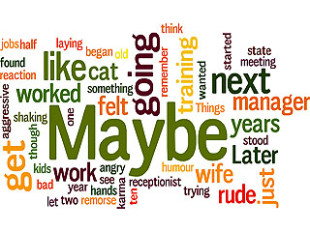
Just maybe…
http://www.patientvoices.org.uk/flv/1214pv384s.htm

Slide 14
Questions for reflection
How might these stories relate to the quality of patient care, satisfaction and outcomes?
How do the stories illustrate the impact of bullying and harassment in the workplace?
How might these stories can be used to support initiatives reducing the impact of bullying and harassment in the workplace?
How do these stories illustrate the impact of bullying and harassment in the health and well being of individuals and their loved ones?
How do these stories/this story connect with your own values or the things that really matter to you?

Slide 15
Questions for reflection
What three things do these stories focus our attention on, in terms of what we should do next?
Having seen “Diagnosis”, how could trade unions better support individuals facing bullying and harassment?
Having seen “Rise Above it” and “Choice”, how can organisations support and listen to concerns raised by individuals experiencing bullying and harassment?
Having seen “Betrayed”, what can organisations do to retain staff who face bullying or harassment?
How might these stories encourage leaders to tackle bullying and harassment in the workplace?

